Slide 1
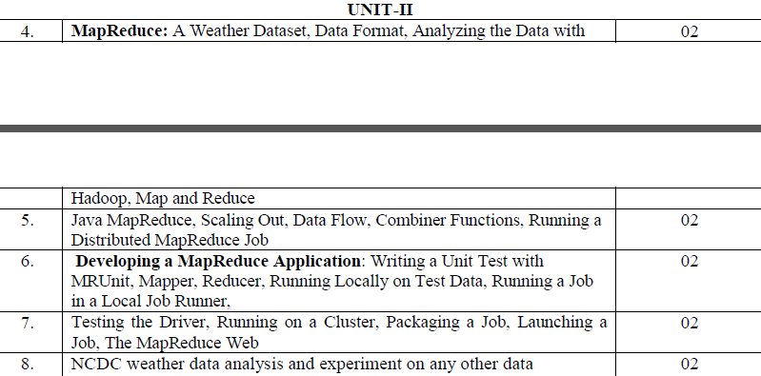
UNIT II

Slide 2
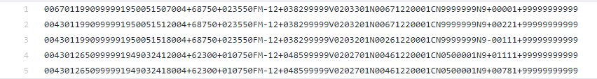
Weather dataset sample

Slide 3
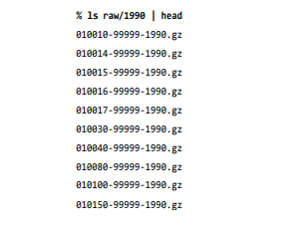

Slide 4
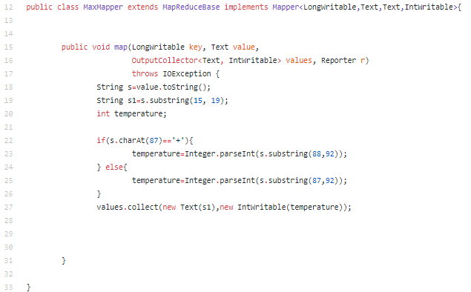

Slide 5
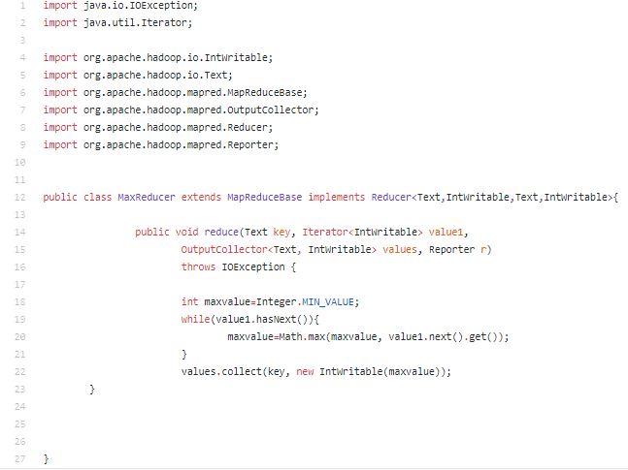

Slide 6
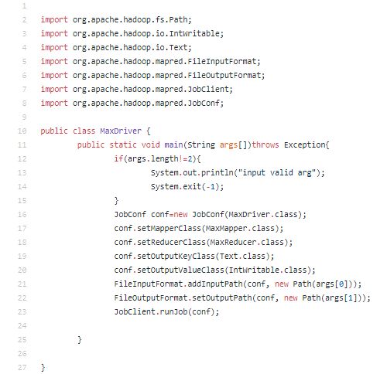

Slide 7
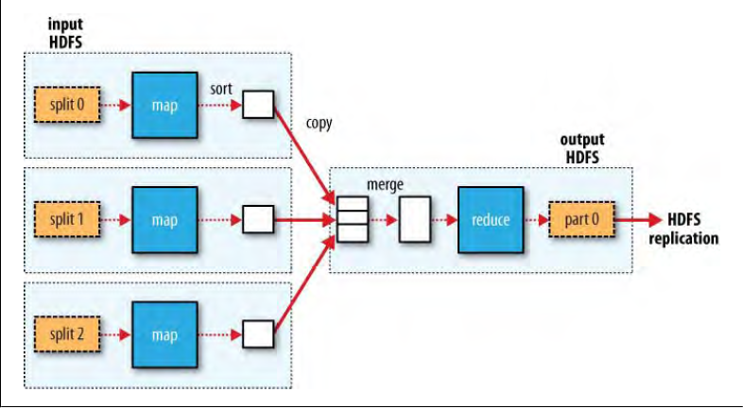
Scaling Out
Scaling Out
Fig: Data flow in single reduce tasks

Slide 8
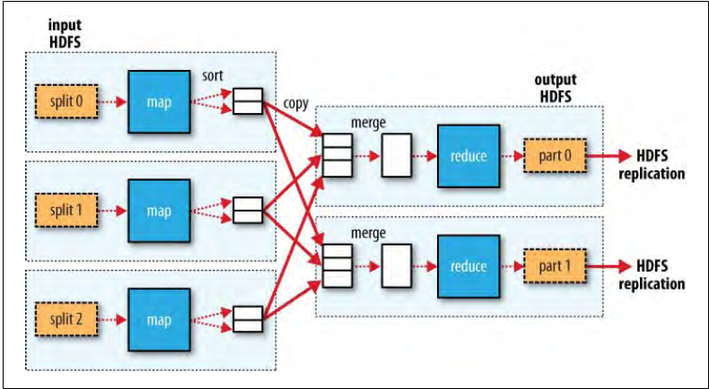
Fig: Data flow in mult reduce tasks

Slide 9
Combiner
Reduce the amount of intermediate data before sending them to reducers.
Pre-aggregation
The interface is exactly the same as reducer.

Slide 10
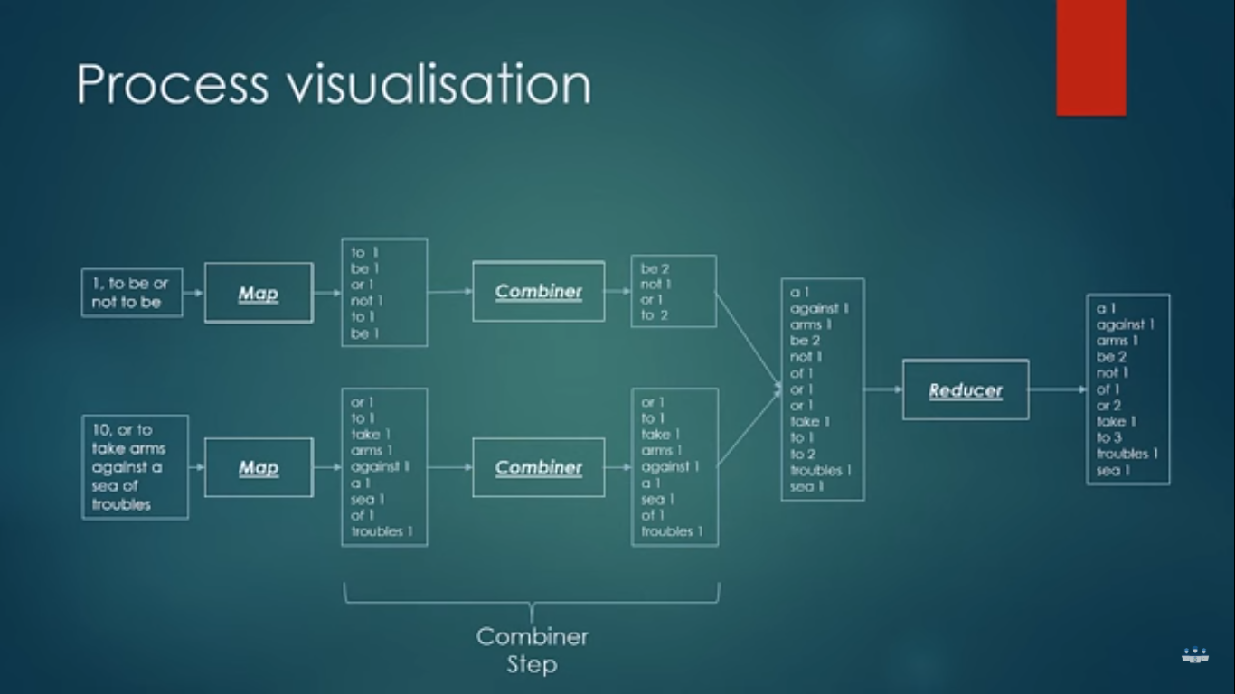

Slide 11
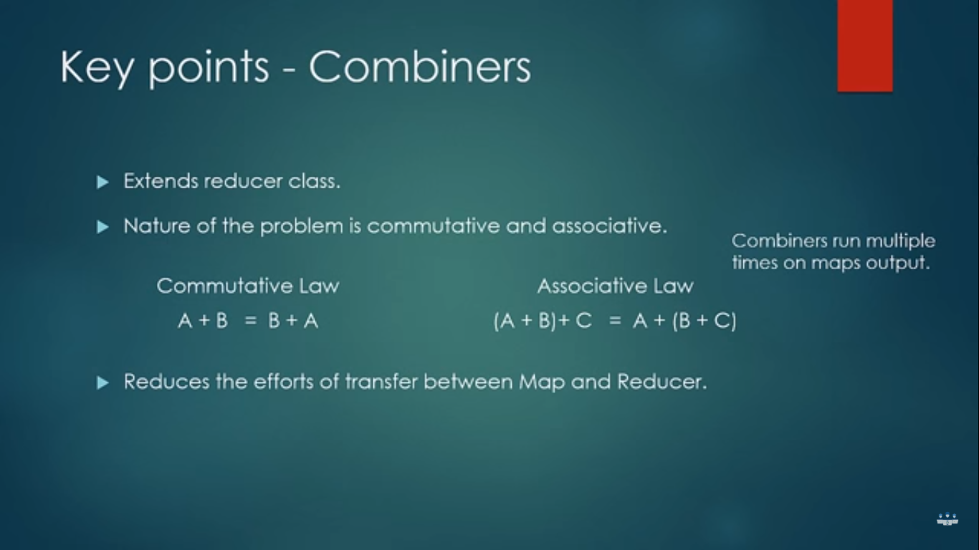

Slide 12
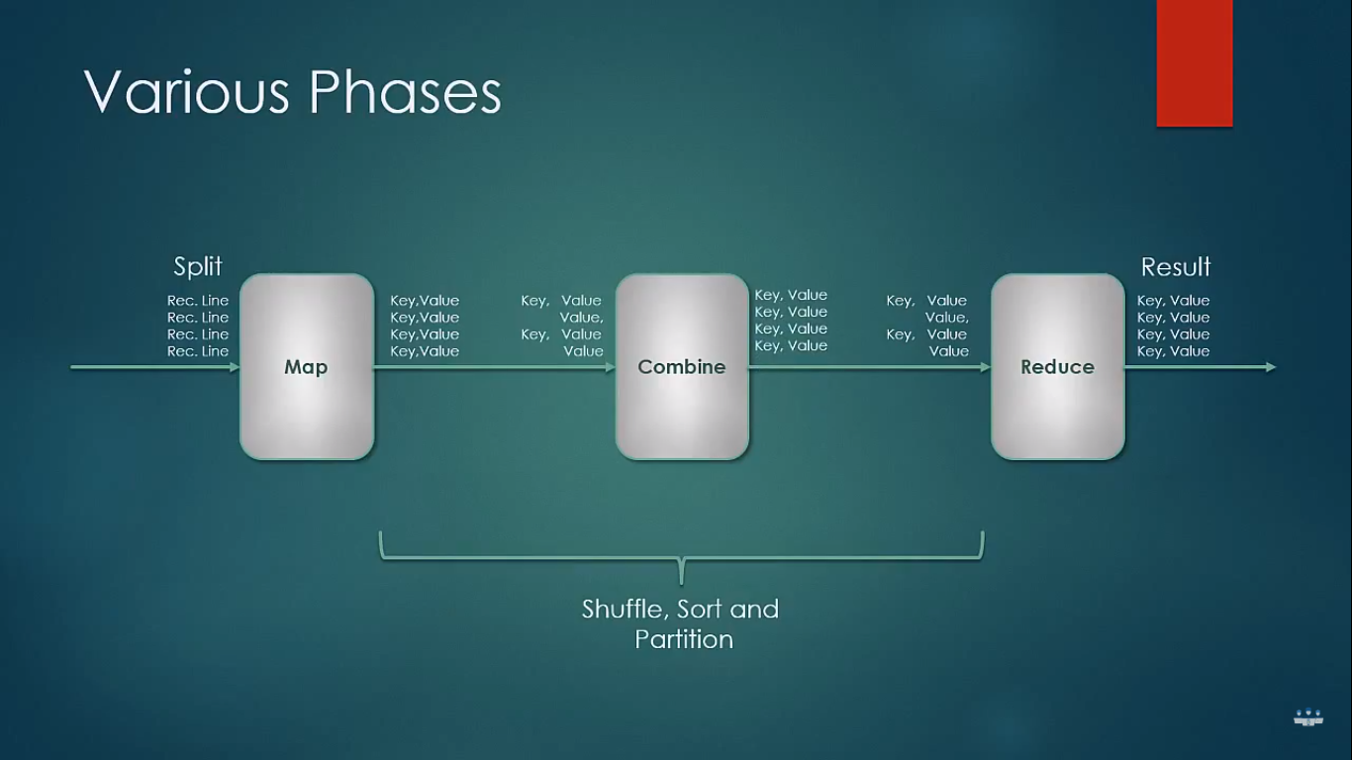

Slide 13
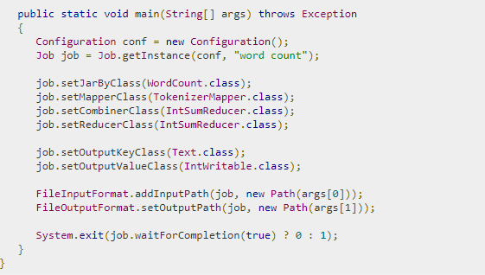

Slide 14
Partitioner
Determine which reducer/partition one record should go to
Given the key, value and number of partitions, return an integer
Partition: (K2, V2, #Partitions) → integer

Slide 15
Partitioner
Interface:
public interface Partitioner<K2, V2> extends JobConfigurable {
int getPartition(K2 key, V2 value, int numPartitions);
}
Implementation:
public class myPartitioner<K2, V2> implements Partitioner<K2, V2> {
int getPartition(K2 key, V2 value, int numPartitions) {
your logic!
}
}

Slide 16
Partitioner
Example:
public class myPartitioner<Text, Text> implements Partitioner<Text, Text> {
int getPartition(Text key, Text value, int numPartitions) {
int hashCode = key.hashCode();
int partitionIndex = hashCode mod numPartitions;
return partitionIndex;
}
}

Slide 17
Partitioner
Node 1
Node 2
Files loaded from local HDFS store
Files loaded from local HDFS store
InputFormat
InputFormat
file
Split
Split
Split
Split
Split
Split
file
file
file
RecordReaders
RR
RR
RR
RR
RR
RR
RecordReaders
Input (K, V) pairs
Input (K, V) pairs
Map
Map
Map
Map
Map
Map
Intermediate (K, V) pairs
Shuffling
Process
Intermediate
(K,V) pairs
exchanged by
all nodes
Intermediate (K, V) pairs
Partitioner
Partitioner
Sort
Sort
Reduce
Reduce
Final (K, V) pairs
Final (K, V) pairs
OutputFormat
OutputFormat
Writeback to local HDFS store
Writeback to local HDFS store

Slide 18
Hadoop streaming
Hadoop comes with the streaming jar in it’s lib directory,
Hadoop Streaming is a generic API which allows writing Mappers and Reduces in any language.
But the basic concept remains the same.
Mappers and Reducers receive their input and output on stdin and stdout as (key, value) pairs.
Apache Hadoop uses streams as per UNIX standard between your application and Hadoop system.
Streaming is the best fit for text processing.
The data view is line oriented and processed as a key/value pair separated by 'tab' character. The program reads each line and processes it as per the requirement.

Slide 19
Imp:
Hadoop Streaming uses Unix standard stream as the interface between Hadoop and your program, so you can use any language that can read standard input and write to standard output to write your MapReduce program.

Slide 20
Word Count in Python with Hadoop Streaming
Mapper.py:
import sys
for line in sys.stdin:
for word in line.split():
print(word.lower() + "\t" + 1)
Reducer.py:
import sys
counts = {}
for line in sys.stdin:
word, count = line.split("\t")
dict[word] = dict.get(word, 0) + int(count)
for word, count in counts:
print(word.lower() + "\t" + 1)

Slide 21
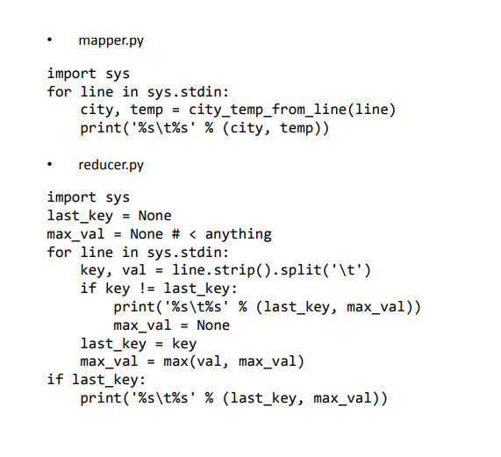

Slide 22
#!/usr/bin/env python
import sys
(last_key, max_val) = (None, 0)
for line in sys.stdin:
(key, val) = line.strip().split("t")
if last_key and last_key != key:
print "%st%s" % (last_key, max_val)
(last_key, max_val) = (key, int(val))
else:
(last_key, max_val) = (key, max(max_val, int(val)))
if last_key:
print "%st%s" % (last_key, max_val)
#!/usr/bin/env python
import re
import sys
for line in sys.stdin:
val = line.strip()
(year, temp, q) = (val[15:19], val[87:92], val[92:93])
if (temp != "+9999" and re.match("[01459]", q)):
print "%st%s" % (year, temp)

Slide 23
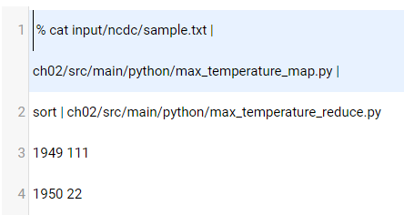

Slide 24
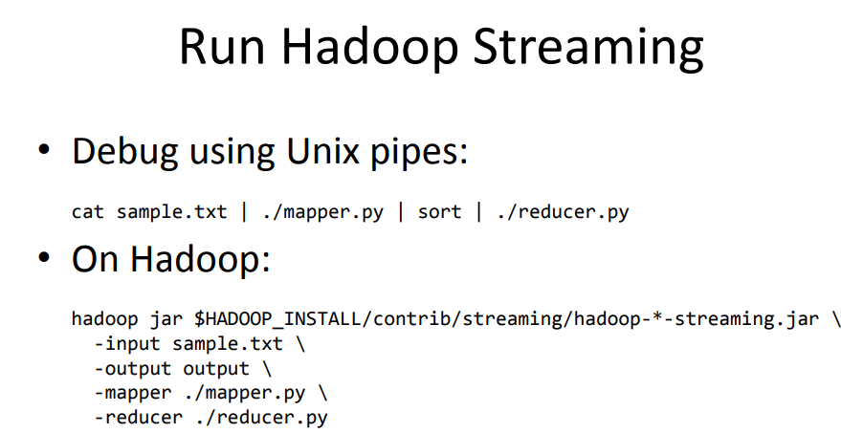

Slide 25
MR UNIT Test
Create a new Java project in Eclipse then add JUnit Library.
Add external Jars which are required to run Junit test case
mrunit-x.x.x-incubating-hadoop1.jar instead of mrunit-x.x.x-incubating-hadoop2.jar
In Addition we need to also add wordcount.jar ( The classes from wordcount.jar will be used in JUnit test case)

Slide 26
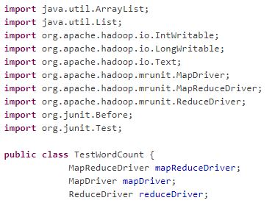
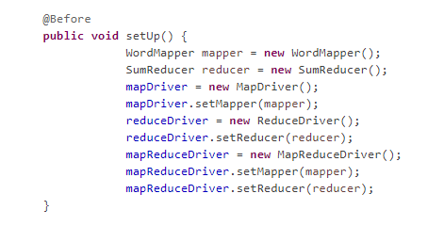
2
1

Slide 27
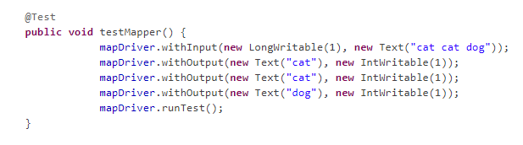
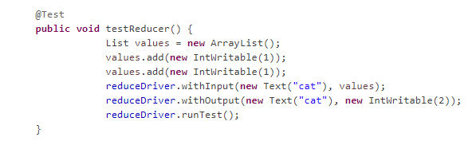
3
4

Slide 28
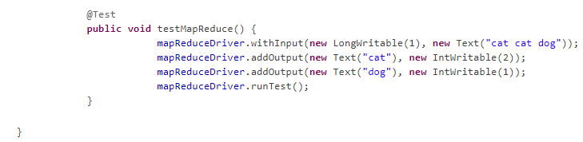
5

Slide 29
Packaging
we do need to package the program as a JAR file to send to the cluster
using Ant
<jar destfile="job.jar" basedir="${classes.dir}"/>
If you have a single job per JAR, then you can specify the main class to run in the JAR file’s manifest. If the main class is not in the manifest, then it must be specified on the command line (Also, any dependent JAR files should be packaged in a lib subdirectory in the JAR file. (This is analogous to a Java Web application archive, or WAR file, except in that case the JAR files go in a WEB-INF/lib subdirectory in the WAR file.)

Slide 30
Launching a Job
To launch the job, we need to run the driver, specifying the cluster that we want to run the job on with the -conf option
% hadoop jar job.jar v3.MaxTemperatureDriver -conf conf/hadoop-cluster.xml input/ncdc/all max-temp
The runJob() method on JobClient launches the job and polls for progress, writing a line summarizing the map and reduce’s progress

Slide 31
The MapReduce Web UI
Hadoop comes with a web UI for viewing information about your jobs. It is useful for following a job’s progress while it is running, as well as finding job statistics and logs after the job has completed.

Slide 32
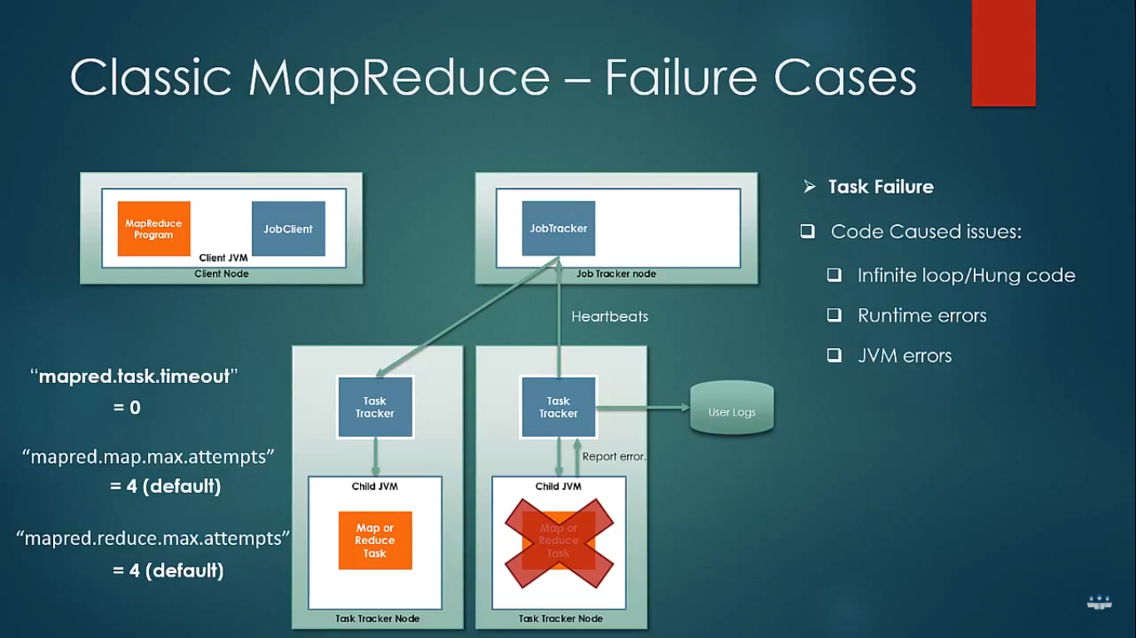

Slide 33
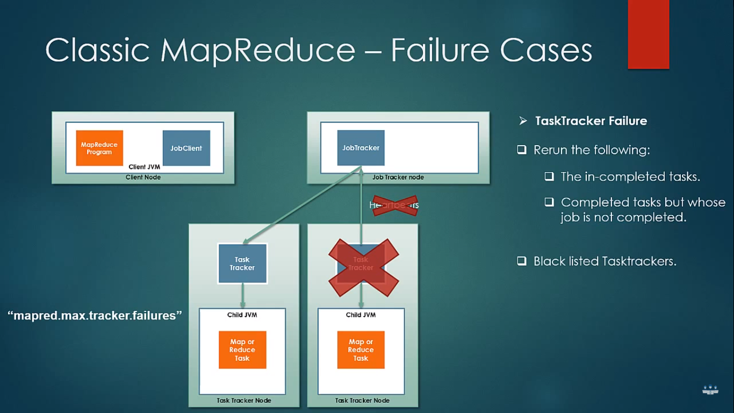

Slide 34
